Slide 1
Challenge: Long Deployment Lifecycle
Model
Re-Code
Validate
Deploy
Conversion in months
Results:
Slow innovation rates
Stale models
Errors
Extended testing & validation cycles
Notes:
This is the traditional deployment process: after the model is built, it took a long time to convert it to other programming languages and then integrate with business apps in production. It is an error prune process with slow innovation rates.

Slide 2


1
2
Easy Consumption
Explore and consume services in R directly
Data Scientist
Easy Deployment
Turn R into web services in one line of code
Microsoft R Client
(mrsdeploy package)
Data Scientist
Services / Sessions
getService
Microsoft R Client
(mrsdeploy package)
publishService
Microsoft R Server
configured for
operationalizing R analytics
REST API calls
Apps
3
Easy Integration
Swagger-based APIs: easy to consume with any programming language
R Server V9 Operationalization Demo
Developer
Notes:
Microsoft R Server V9 introduces a new deployment solution. It exposes R models as web services so that Line of Business applications can integrate them without any translation, and developers don’t need to know R.
I will demo 3 experiences today.
The first one, how to easily deploy the model we just built in HDI as a web service
The 2nd one, how to easily consume this web service inside R by another data scientist.
Thinking about the scenario that as a data scientist in QA team, after a model is deployed into production, I can validate and monitor its performance with the new production data, from R!
The 3rd one, how to easily integrate this web service into an application written with C#.
Thinking about the scenario of integrating the prediction service with an online booking application. After I searched a flight, I can see the flight delay prediction. It will help me make better choice.

Slide 3
Easy Consumption
Explore and consume services in R directly
Data Scientist
Easy Deployment
Turn R into web services in one line of code
Microsoft R Client
(mrsdeploy package)
Data Scientist
Services / Sessions
getService
Microsoft R Client
(mrsdeploy package)
publishService
Microsoft R Server
configured for
operationalizing R analytics
REST API calls
Easy Setup
In-cloud or on-prem
Adding nodes to scale
High availability & load balancing
Remote execution server
Apps
Easy Integration
Swagger-based APIs: easy to consume with any programming language
Developer
Notes:
To run the demo, we need to set up an R server to host the web services. Due to the time limitations, I will not demo the set up and configuration. I will use a server already running in Azure. We have detail instructions in our online product documentation about the set up and configuration.

Slide 4
Demo in R Tools for Visual Studio 1st and 2nd experience
Notes:
Now, let’s start the demo. The first experience, deploy the model as a web service.
I’ve chosen to do my work in R Tools for Visual Studio. The demo will actually work with any R IDEs, such as RStudio. The R scripts are in the left pane and results will be shown in the right pane.
This is the model we just built in HDI in previous demo. We load it, associate with the training data’s column info, and wrap it with a scoring function. The function’s input data is a batch data set for scoring.
Now let’s test this function. We can see the 900 predictions for each row of the data set.
The next step is to login to the remote R Server. As I mentioned before, we already set up a server in Azure.
The last step, let’s deploy the model as a service. We can define the inputs and output for developer to easily consume it. We can define the version number for version control. With this line of code, we got a service hosted in remote R server.
We can now verify it right away, without leaving R! We saw the same 900+ prediction results.
################################
# Demo the 2nd experience
################################
We have completed the demo of the first experience. Now let’s demo the 2nd experience: how other data scientists can consume this web service.
Assume now I am another data scientist from QA team. I am going to verify the Flight Prediction web service just published by model team.
First, I use listServices function to list all available services. I can explore and choose the one that I am interested. I find out the one just published. I choose it.
Then I use getService function to consume the functions of that service. I can use the new flight data to verify and monitor the deployed models. The whole process is in R, so it is easy and nature for me.
Consuming these services in R is a unique capability of Microsoft R Sever. It enables a set of exciting scenarios. For example, since data scientist can deploy not only models, but any arbitrary R scripts/functions, they can share the useful functions for other data scientist to quickly consume.

Slide 5

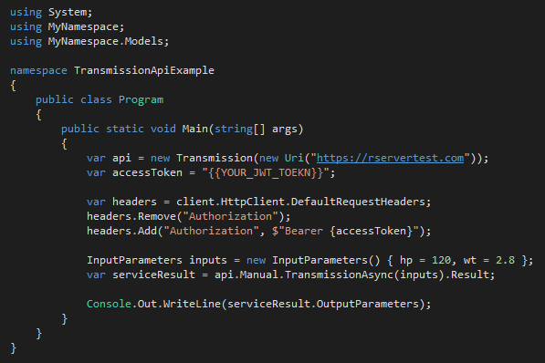
Integration with Apps Swagger based APIs, easy to consume, with any programming language
Data Scientist
Developer
Developer
Generate Swagger Docs for Web Services
Run Swagger tools to generate code
Write a few code to consume the service
Popular Swagger Tools: AutoRest or Code Generator
# Run the following code in R
swagger <- api$swagger()
cat(swagger, file = "swagger.json", append = FALSE)
AutoRest.exe -CodeGenerator CSharp -Modeler Swagger -Input swagger.json -Namespace FlightService
Notes:
The last experience I am going to demo is how to easily integrate this web service with a C# app. We leverage Swagger to achieve this goal. Swagger is the most popular open source API framework. It greatly simplifies the consumption of RESTful web services. By adding the Swagger description to our RESTful web services, developers can generate the codes easily.
It took 3 very easy steps to integrate the web service to an application.
First, data scientist generates the swagger doc, with 2 line of code.
Second, developer uses open source tools such as AutoRest to generate the sample code for the web services.
Last step, developer writes a few line of C# codes to consume the service. They will use the autogenerated code. You can see that during the whole process the developers don’t need to see R code at all.
That’s all for today’s demo. Easy deployment, easy consumption from R and easy integration with Apps. Thank you!

